Slide 1
Introduction to Web Basics
Basics of Web Development
Saurabh Singh

Slide 2
Understanding how web works

Slide 3
Understanding how web works
Request
Response
Critical Rendering Path(CRP)

Slide 4
TOPICS TO BE COVERED:
Overview
Main Participants
HTTP as the Transport Protocol
Structure of an HTTP Request and Response
Common HTTP Methods and Their Meaning
Status Codes (Server Feedback)
Stateless Nature and Its Implications
Simple Request–Response Flow (Visualized)
Request–Response vs Other Models

Slide 5
Response Request
Client sends a request
Server processes the request
Server sends back a response
Client consumes the response

Slide 6
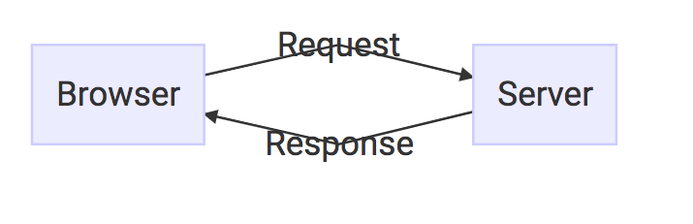

Slide 7
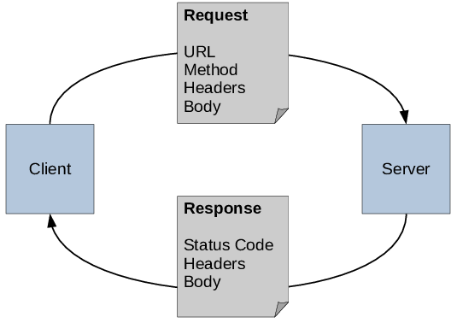
Main Participants
The client(Chrome, Firefox, Mobile App, Microservices)
The server(web server or application server, Host resources like HTML pages, APIs, files, or data)

Slide 8
HTTP (Hypertext Transfer Protocol)
Stateless
Synchronous by default
Structure of HTTP Request
Request Line(GET , POST, PUT, DELETE)
Header(Metadata (Content-Type, Authorization, Cookies, etc.))
Body
Structure of HTTP Response
Status line(200, 400, 500, 404,etc)
Headers(Content-Type, Cache-Control, etc.)
Response(Actual Data (json, image, HTML))

Slide 9
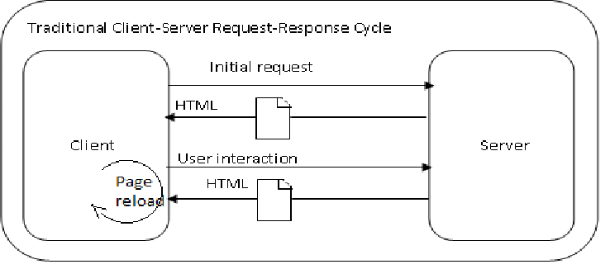

Slide 10
HTTP Methods and their meaning
Method | Purpose
GET | Retrieve data
POST | Create new data
PUT | Replace existing data
PATCH | Partially update data
DELETE | Remove data

Slide 11
Status Codes (Server Feedback)
2xx – Success (200 OK, 201 Created)
3xx – Redirection (301, 302)
4xx – Client error (400 Bad Request, 401 Unauthorized, 404 Not Found)
5xx – Server error (500 Internal Server Error)
Stateless Nature and Its Implications
server does not remember previous requests
Request–Response vs Other Models
Traditional REST APIs strictly follow request–response, while modern real-time systems extend beyond it

Slide 12
Why This Model Matters
Scalibility
Debugging and monitoring
Forms the basis of
REST APIs
Microservices
Web applications
Cloud-native systems

Slide 13
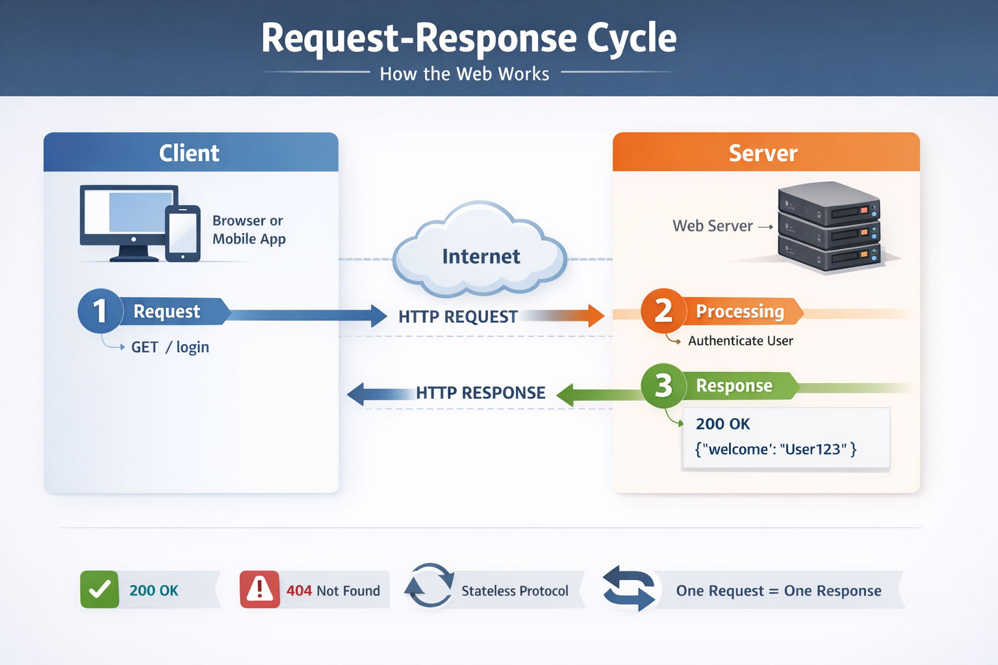


Slide 14
Explore HTML document structure

Slide 15
Explore HTML document structure
Topics to be covered
What Is an HTML Document?
Basic HTML Document Skeleton
<!DOCTYPE html>
<html> element
<head> section
<meta> tags
<title> tags
<body> section
Common HTML tags (Basic and advanced)
Key practice

Slide 16
What Is an HTML Document?
An HTML document defines the structure and content of a web page. Browsers interpret HTML to render text, images, links, forms, and other elements.
Every valid HTML document follows a predictable skeleton.

Slide 17
Basic HTML Document Skeleton
Syntax:
<!DOCTYPE html>
<html lang="en">
<head>
<meta charset="UTF-8">
<title>My First Web Page</title>
</head>
<body>
<h1>Hello World</h1>
<p>This is my first HTML page.</p>
</body>
</html>

Slide 18
<!DOCTYPE html>
Declares the document type
Tells the browser to use HTML5 standards
Must be the first line in the document
Without it, browsers may fall back to quirks mode, causing layout issues. Syntax: <!DOCTYPE html>

Slide 19
<html> Element
Root element of the document
Wraps everything
Lang attribute helps:
Screen readers
Search engines
Accessibility tools Syntax: <html lang="en">

Slide 20
<head> Section
The <head> contains metadata and configuration, not visible page content.
Common Uses of <head>
Character encoding
Page title
SEO metadata
CSS links
JavaScript references
Syntax:
<head>
<meta charset="UTF-8">
<meta name="description" content="HTML basics">
<meta name="viewport" content="width=device-width, initial-scale=1.0">
<title>HTML Structure</title>
</head>

Slide 21
<meta> Tags
<meta> provides information about the page.
Character Encoding
Supports all languages and symbols
Always include this early in <head> Syntax: <meta charset="UTF-8">
Viewport (Responsive Design)
Critical for mobile-friendly layouts Syntax:<meta name="viewport" content="width=device-width, initial-scale=1.0">
SEO Metadata Syntax:<meta name="description" content="Learn HTML document structure”> <meta name="keywords" content="HTML, web development"> <meta name="author" content="Gaurav Singh">

Slide 22
<title> tags
Appears in:
Browser tab
Search engine results
One <title> per document
Required for valid HTML Syntax: <title>HTML Basics</title>

Slide 23
<body> section
The <body> contains everything visible to users.
Syntax: <body>
<h1>Main Heading</h1>
<p>This content is visible on the page.</p>
</body>

Slide 24
Common HTML tags inside <body>
Basic HTML tags
Tag | Category | Purpose / Description | Example
<h1> – <h6> | Heading | Defines headings from highest to lowest level | <h1>Main Title</h1>
<p> | Text | Represents a paragraph | <p>Paragraph text</p>
<a> | Link | Creates hyperlinks | <a href="url">Link</a>
<img> | Media | Displays an image | <img src="img.jpg" alt="Image">
<br> | Formatting | Inserts a line break | Text<br>Next line
<hr> | Formatting | Inserts a horizontal line | <hr>
<strong> | Text | Strong importance (bold) | <strong>Important</strong>
<em> | Text | Emphasized text (italic) | <em>Emphasis</em>
<ul> | List | Unordered (bulleted) list | <ul><li>Item</li></ul>
<ol> | List | Ordered (numbered) list | <ol><li>Step</li></ol>
<li> | List | List item | <li>Item</li>
<div> | Container | Block-level grouping element | <div>Content</div>
<span> | Container | Inline grouping element | <span>Text</span>

Slide 25
Common HTML tags inside <body>
Advanced HTML Tags
Tag | Category | Purpose / Description | Example
<form> | Form | Container for user input | <form>...</form>
<input> | Form | Input control | <input type="text">
<textarea> | Form | Multi-line text input | <textarea></textarea>
<button> | Form | Clickable button | <button>Submit</button>
<label> | Form | Label for form elements | <label>Name</label>
<table> | Table | Creates a table | <table>...</table>
<tr> | Table | Table row | <tr>...</tr>
<th> | Table | Header cell | <th>Title</th>
<td> | Table | Data cell | <td>Data</td>
<header> | Semantic | Header section | <header>...</header>
<nav> | Semantic | Navigation links | <nav>...</nav>
<section> | Semantic | Logical section | <section>...</section>
<article> | Semantic | Independent content block | <article>...</article>
<footer> | Semantic | Footer section | <footer>...</footer>
<main> | Semantic | Main page content | <main>...</main>
<aside> | Semantic | Side content | <aside>...</aside>

Slide 26
HTML Document Structure Summary
Component | Purpose
<!DOCTYPE> | Declares HTML5
<html> | Root element
<head> | Metadata and configuration
<meta> | Encoding, SEO, responsiveness
<title> | Browser tab title
<body> | Visible webpage content

Slide 27
Key Best Practices
Always include<!DOCTYPE html>
Use semantic tags (<header>, <nav>, <main>, <footer>) when possible
Keep metadata clean and minimal
Maintain proper heading hierarchy
Add alt attributes for images

Slide 28
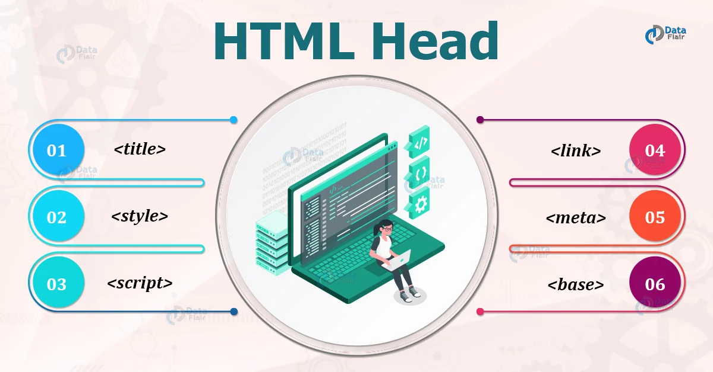

Slide 29
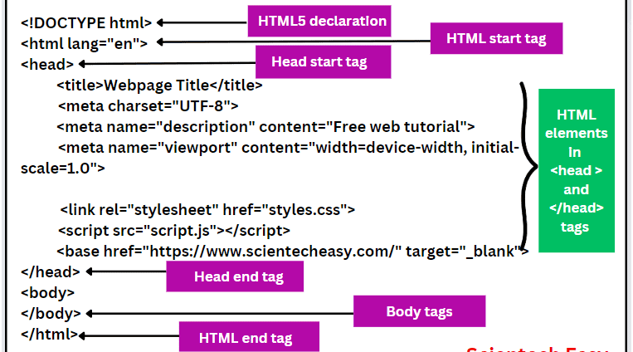

Slide 30
Use semantic HTML and ARIA to build accessible pages.

Slide 31
Use semantic HTML and ARIA to build accessible pages
Topics to be covered
Prefer semantic elements over generic containers
Page landmarks and heading structure
Forms: labels, descriptions, and errors
Buttons, links, and interactive controls
Images and icons
ARIA: what to use, and what to avoid
Common UI patterns (minimal, correct ARIA)
Keyboard and focus fundamentals
Tables
Practical validation steps

Slide 32
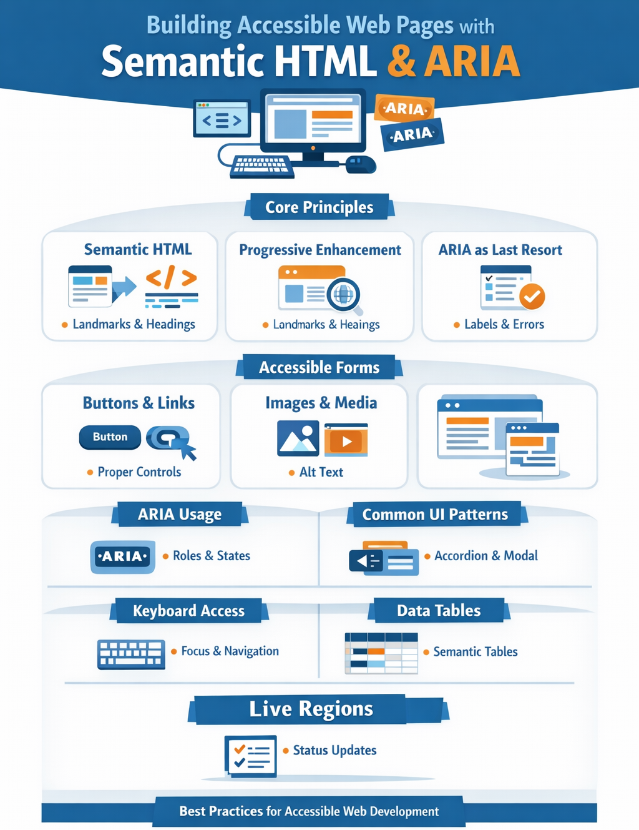

Slide 33
Prefer semantic elements over generic containers
Semantic elements come with built-in roles, keyboard behaviors, and accessibility mappings.
Structure: header, nav, main, footer, aside, section, article
Content: h1–h6, p, ul/ol/li, figure/figcaption
Interaction: button, a, input, select, textarea, details/summary
Data: table, thead/tbody/tfoot, th with scope
Avoid building interactive UI from div/span. If it’s clickable, it should usually be a button or a.

Slide 34
Page landmarks and heading structure
Landmarks help screen-reader users navigate quickly.
One main per page.
Use headings in a logical outline (do not jump from h1 to h4).
Use nav for major navigation blocks.
Example:: <a class="skip-link" href="#main">Skip to main content</a>
<header>
<h1>Site Name</h1>
</header>
<nav aria-label="Primary">
<!-- nav links -->
</nav>
<main id="main">
<h2>Page heading</h2>
<!-- content -->
</main>
<footer>
<!-- footer -->
</footer>

Slide 35
Forms: labels, descriptions, and errors
Forms are where ARIA is often useful, but start with native patterns.
Always associate a visible label: <label for=“id”>.
Use fieldset + legend for grouped controls (radio/checkbox sets).
Use aria-describedby for hint text or error text tied to a field.
Indicate errors with aria-invalid="true" and an error message.
Example: <label for="email">Email</label>
<input id="email" name="email" type="email"
aria-describedby="email-hint email-error"
aria-invalid="true" />
<p id="email-hint">We will never share your email.</p>
<p id="email-error">Enter a valid email address.</p>

Slide 36
Buttons, links, and interactive controls
Use the correct element to get keyboard support “for free.”
Use <button> for actions (submit, open modal, toggle).
Use <a href="..."> for navigation (must have href).
Don’t put click handlers on non-interactive elements unless you fully replicate keyboard and semantics (generally avoid).
Icon-only buttons
<button type="button" aria-label="Close dialog">
<!-- icon -->
</button>

Slide 37
Images and icons
Informative images: meaningful alt.
Decorative images: empty alt="" (or CSS background).
Avoid redundant alt like “image of …” unless necessar
Example
<img src="chart.png" alt="Revenue increased from 10M to 18M between 2023 and 2025.">
<img src="divider.png" alt="">

Slide 38
ARIA: what to use, and what to avoid
Use ARIA when:
You need to name/describe elements: aria-label, aria-labelledby, aria-describedby
You need dynamic state: aria-expanded, aria-pressed, aria-selected
You need relationships: aria-controls (used carefully)
You need live updates: aria-live (for async status messages)
You need dialogs/menus only when native elements can’t achieve the pattern

Slide 39
ARIA: what to use, and what to avoid
Avoid
Adding roles to elements that already have correct semantics (e.g., role="button" on a <button>).
aria-hidden=“true" on focusable/interactive content (creates traps and confusion).
Overusing role="application" (almost never needed)
Custom widgets without full keyboard model and focus management. Rule of thumb: No ARIA is better than wrong ARIA.

Slide 40
Common UI patterns (minimal, correct ARIA)
Disclosure / accordion
Use button with aria-expanded and a controlled region: Example:
<button type="button" aria-expanded="false" aria-controls="faq1">
What is your refund policy?
</button>
<div id="faq1" hidden>
<p>We offer refunds within 30 days.</p>
</div>
Update aria-expanded and hidden together.

Slide 41
Common UI patterns (minimal, correct ARIA)
Dialog / modal
Key requirements: focus trap, initial focus, return focus, Esc to close, background inert/blocked button with aria-expanded and a controlled region: Example:
<div role="dialog" aria-modal="true" aria-labelledby="dlg-title" hidden>
<h2 id="dlg-title">Confirm delete</h2>
<p>Are you sure?</p>
<button type="button">Delete</button>
<button type="button">Cancel</button>
</div>
If you can, prefer the native <dialog> element (still requires careful focus handling and browser support checks)

Slide 42
Common UI patterns (minimal, correct ARIA)
Live status updates
For async saves, uploads, etc.: Example:
<div aria-live="polite" aria-atomic="true" id="status"></div>
Write brief, non-spammy updates into #status.

Slide 43
Keyboard and focus fundamentals
Accessibility fails most often due to focus issues.
All interactive elements must be reachable with Tab.
Focus order should match visual order.
Provide visible focus styles (do not remove outlines without replacement).
When content appears/disappears (dialogs, menus), manage focus explicitly.

Slide 44
Tables
Use real table semantics.
Use <th scope="col"> / <th scope=“row">
Provide captions for context with <caption> when helpful
<table>
<caption>Quarterly revenue (USD)</caption>
<thead>
<tr><th scope="col">Quarter</th><th scope="col">Revenue</th></tr>
</thead>
<tbody>
<tr><th scope="row">Q1</th><td>10M</td></tr>
</tbody>
</table>

Slide 45
Differentiate block vs inline elements and their impact on layout and flow.

Slide 46
Differentiate block vs inline elements and their impact on layout and flow
Topics to be covered
What are Block Elements
Inline Elements
Side-by-Side Comparison
Impact on Layout Design
Inline-Block (Important Bridge)
Key Practice

Slide 47
Block Elements
Definition
Block elements create a block box that:
Starts on a new line
Expands to the full available width by default

Slide 48
Block Elements
Layout & Flow Behavior
Each block element forces a line break before and after itself.
They participate in vertical layout flow.
Margin collapsing applies (top and bottom margins may merge).

Slide 49
Block Elements
Box Model Support
Block elements fully support:
width / height
Margin (all sides)
padding
border

Slide 50
Block Elements
Typical Use Cases
Page structure
Layout containers
Sections of content
Common Examples: <div>, <p>, <h1>–<h6>, <section>, <article>, <header>, <footer>, <ul>, <ol>, <li>
Example: <div style="background: lightblue;">Block 1</div> <div style="background: lightgreen;">Block 2</div> Result: Each <div> appears on its own line, stacked vertically.

Slide 51
Inline Elements
Definition
Do not start on a new line
Occupy only as much width as their content

Slide 52
Inline Elements
Layout & Flow Behavior
Flow within a line of text
Do not disrupt surrounding text
Do not create vertical breaks

Slide 53
Inline Elements
Box Model Limitations
Ignore width and heigh
Respect padding and margin horizontally
Vertical margins/padding do not affect line height reliably

Slide 54
Inline Elements
Typical Use Cases
Styling text structure
Small semantic annotations
Inline interactions
Common Examples: <span>, <a>, <strong>, <em>, <code>, <label>
Example: <<p> This is <span style="color: red;">inline text</span> inside a paragraph. </p> Result: The <span> stays within the same line as surrounding text.

Slide 55
Side-by-Side Comparison
Feature | Block | Inline
Starts on new line | Yes | No
Takes full width | Yes (default) | No
Width & height | Supported | Ignored
Vertical margins | Supported | Not effective
Can contain block elements | Yes | No
Affects document flow | Vertical stacking | Inline text flow

Slide 56
Impact on Layout Design
Block Elements
Form the structural skeleton of a page
Used for grids, sections, and layouts
Essential for responsive design and positioning

Slide 57
Impact on Layout Design
Inline Elements
Used for content-level styling
Cannot control layout by themselves
Ideal for typography and inline interactions

Slide 58
Inline-Block
Important Bridge
Behavior
Flows inline like text
Acccepts width, height, margins, and padding
Use Case
Buttons
Navigation items
Cards inside a row
Syntax: display: inline-block;

Slide 59
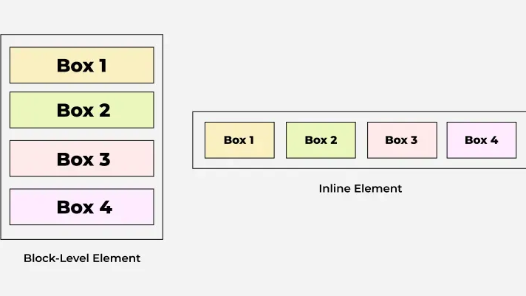

Slide 60
Key Practice
Block elements control page structure and vertical flow
Inline elements control text-level formatting and inline flow
Choosing the wrong type leads to layout bugs and CSS workarounds

Slide 61
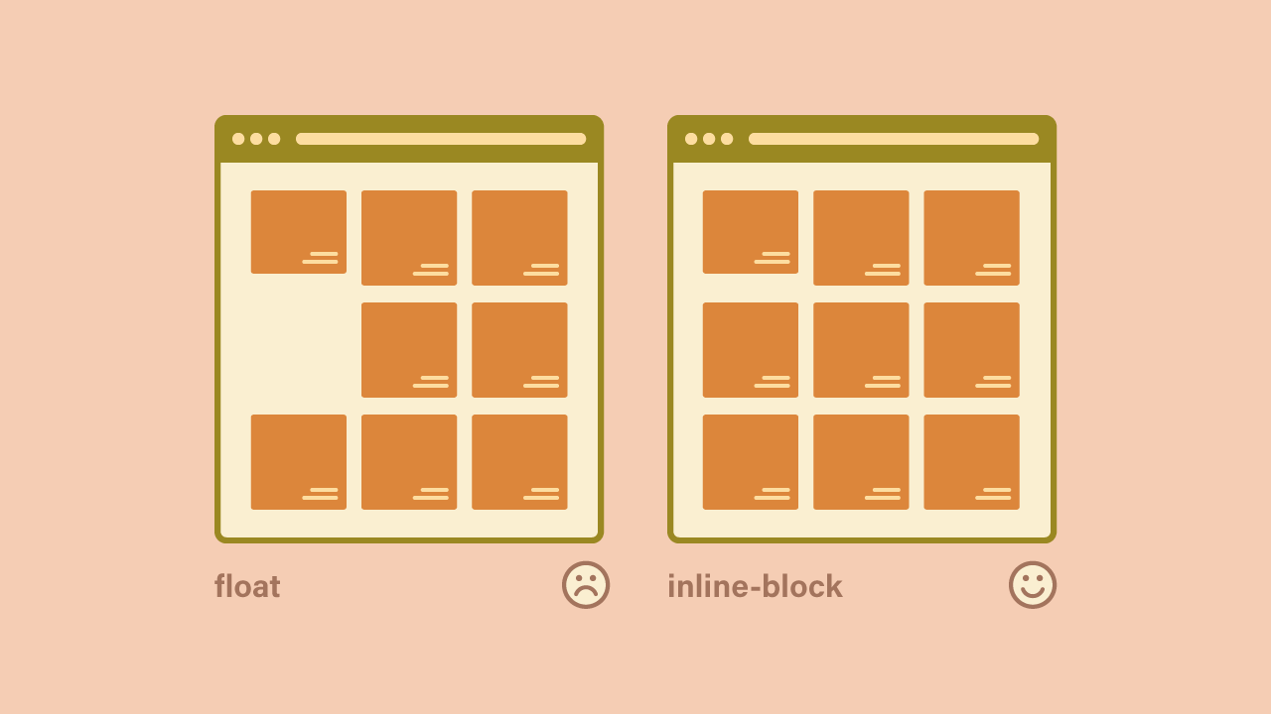

Slide 62
Learn Git essentials: repository, commit, branch, and basic workflow.

Slide 63
Learn Git essentials: repository, commit, branch, and basic workflow.
Topics to covered
What Is Git?
Repository (Repo)
Commit
Branch
Basic Git Workflow (End to End)

Slide 64
What is Git
Git is a distributed version control system used to track changes in source code and other files over time.
It allows multiple people to work on the same project safely, keeps history, and enables rollback to earlier states.

Slide 65
Repository(Repo)
A repository is the container for your project
It includes:
All project files (code, assets, documentation)
The complete history of changes
Metadata required by Git
Types of repositories:
Local repository – exists on your machine
Remote repository – hosted on a server (e.g., GitHub, GitLab)

Slide 66
Repository(Repo)
Common commands git init # create a new repository git clone <url> # copy an existing repository
Key idea: A repository is the single source of truth for a project’s history.

Slide 67
Commit
A commit is a snapshot of the project at a specific point in time.
Each commit:
Records what changed
Has a unique ID (hash)
Includes author, timestamp, and message
Think of a commit as:
“I am saving the current state with an explanation.”

Slide 68
Commit
Basic flow:(bash) git status # see what changed git add file.txt # stage changes git commit -m "Meaningful message"
Good commit message example(pgsql) Fix login validation for empty password
Bad example(sql) update

Slide 69
Branch
A branch is an independent line of development.
Why branches exist:
Work on features without breaking main code
Experiment safely
Enable parallel work
Default branch:
Traditionally master
Commonly now main

Slide 70
Branch
Creating and switching branches:(bash) git branch feature-login git checkout feature-login
Shortcut(bash) git checkout -b feature-login
Merging a branch:(bash) git checkout main git merge feature-login
Key idea: Branches let you work in isolation and merge when ready.

Slide 71
Basic Git Workflow (End to End)
Step by Step Workflow
Modify files
Edit code or add new files
Stage changes
git add .
Commit changes
git commit -m "Describe what and why"
Push to remote
git push origin main
Pull latest updates
git pull origin main

Slide 72
Minimal Command Cheat Sheet
git init
git status
git add .
git commit -m "message"
git branch
git checkout -b new-branch
git merge branch-name
git pull
git push

Slide 73
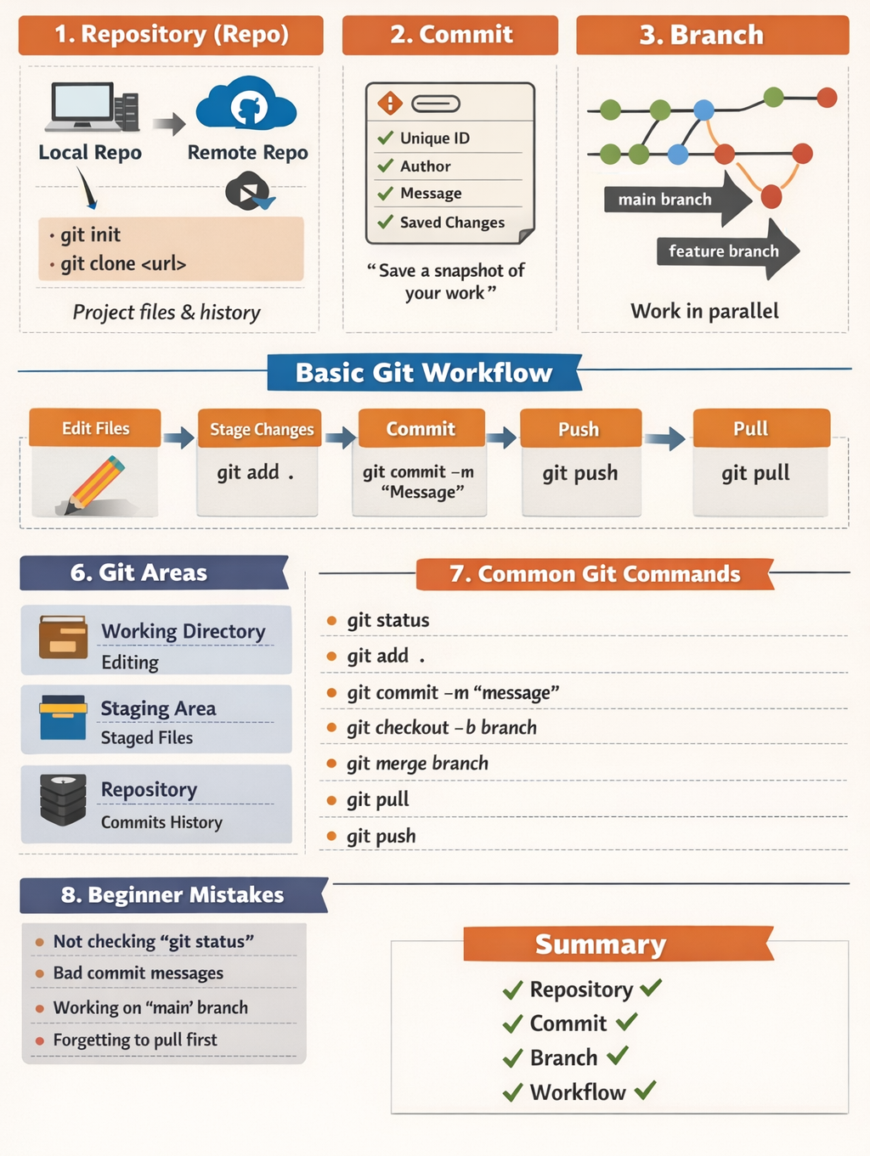

Slide 74
Work with GitHub: remotes, cloning, pushing, pull requests, and collaboration.

Slide 75
Work with GitHub: remotes, cloning, pushing, pull requests, and collaboration.
Topics to be covered
Git vs GitHub (Quick Context)
Repositories and Remotes
Cloning a Repository
Making Changes Locally
Pushing Changes to GitHub
Pulling Changes from GitHub
Branching for Collaboration
Pull Requests (PRs)
Forks and Open-Source Collaboration
Resolving Merge Conflicts
Best Practices for Team Collaboration

Slide 76
Git vs GitHub (Quick Context)
Git
A distributed version control system installed on your machine.
It tracks changes, manages history, and supports branching.
GitHub
A cloud-based hosting platform for Git repositories.
It enables collaboration, code reviews, issue tracking, and CI/CD.
Git works locally. GitHub enables collaboration.

Slide 77
Repositories and Remotes
Repository
A repository (repo) is a project folder tracked by Git.
It contains:
Source code
Commit history
Branches
Configuration files
Remote
A remote is a reference to a repository hosted elsewhere (usually GitHub).
Common remotes:
origin → your main GitHub repo
upstream → original repo (when working on a fork)

Slide 78
Repositories and Remotes
Check remotes: git remote -v
Add a remote git remote add origin https://github.com/user/project.git

Slide 79
Cloning a Repository
Cloning creates a local copy of a GitHub repository on your machine.
Clone commands git clone https://github.com/user/project.git
This:
Downloads the entire history
Automatically sets origin
Creates a working directory

Slide 80
Making Changes Locally
Typical local workflow:
Edit files
Stage changes
Commit changes git status git add . git commit -m "Add feature X"

Slide 81
Making Changes Locally
Key Concepts
Working Directory: modified files
Staging Area: files marked for commit
Commit: snapshot of changes

Slide 82
Pushing Changes to GitHub
push uploads your local commits to a remote repository. git push origin main
If branch does not exists: git push -u origin feature/login

Slide 83
Pulling Changes from GitHub
pull fetches changes from GitHub and merges them into your local branch. git pull origin main
Internally: git fetch git merge
Use this frequently to stay up to date.

Slide 84
Branching for Collaboration
Branches allow:
Parallel development
Safe experimentation
Clean collaboration
Create and switch branch git checkout -b feature/dashboard
List branches git branch

Slide 85
Pull Requests (PRs)
A Pull Request is a request to merge one branch into another (usually main).
It enables:
Code review
Discussion
Automated checks
Typical PR Flow
Create a branch
Commit and push changes
Open PR on GitHub
Review + feedback
Merge PR

Slide 86
Pull Requests (PRs)
Merge Strategies
Merge commit – keeps full history
Squash and merge – single clean commit
Rebase and merge – linear history

Slide 87
Forks and Open-Source Collaboration
Fork:A fork is your own copy of someone else’s repository.
Workflow
Fork repository
Clone your fork
Add upstream remote
Create feature branch
Open PR to upstream repo
Add upstream git remote add upstream https://github.com/original/project.git
Sync with upstream git fetch upstream git merge upstream/main

Slide 88
Resolving Merge Conflicts
Conflict: Occurs when Git cannot automatically merge changes
Steps:
Open conflicted files
Resolve markers: <<<<<<< HEAD ======= >>>>>>>
Stage resolved files
Commit git add . git commit

Slide 89
Best Practices for Team Collaboration
Pull before starting work
Use feature branches (never commit directly to main)
Write clear commit messages
Keep PRs small and focused
Review code carefully
Resolve conflicts early

Slide 90
Common GitHub Commands Summary
Purpose | Command
Clone repo | git clone URL
Check status | git status
Add files | git add .
Commit | git commit -m "msg"
Push | git push origin branch
Pull | git pull origin branch
Create branch | git checkout -b branch
Switch branch | git checkout branch

Slide 91
Using AI tools (ChatGPT/Gemini) to generate HTML/CSS boilerplate

Slide 92
Using Cursor to scaffold starter files and explain rendering flow

Slide 93
AI-generated commit messages
AI-assisted code review for pull requests
AI helps in identifying CSS specificity conflicts

Slide 94
AI in the Modern Developer Workflow
AI-Generated Commit Messages
Automatically summarizes code diffs into clear, structured commits
Improves consistency and traceability
Reduces developer overhead during version control

Slide 95
AI in the Modern Developer Workflow
AI-Assisted Code Review
Flags bugs, security issues, and performance concerns
Enforces coding standards and best practices
Accelerates pull-request feedback cycles

Slide 96
AI in the Modern Developer Workflow
AI-Driven CSS Conflict Detection
Identifies CSS specificity and cascade conflicts
Detects unintended overrides and misuse of !important
Recommends cleaner, maintainable styling patterns

Slide 97
Impact
Faster development cycles
Higher code quality
Reduced review and debugging effor

